Slide 1
Social Factor influencing immigration attitude
Replication and Extension using General Social Survey data
By: Haoran Weng
翁浩然

Slide 2
Attitude toward Immigration
What factors influences people’s opinion concerning immigration?
- Age
- Gender
- Ethnicity
- Economic Status
- Political View
- Education
- Cultural values
- Religion
- Multicultural experiences
Purpose of this Project
To replicate existing research
Use visualization skill to explore data and identify questions for further study.

Slide 3
Replication
Chandler and Tsai (2001) were the first to study US public opinion using General Social Survey data in 1994.
Replication of their findings as my point of departure.
Model. OLS model
- Dependent Variable: Two attitude factors toward legal and illegal immigration constructed from 7 questions concerning people’s attitude toward number of immigrant, concern’s about crime and unemployment, and opinion about political and educational rights for immigrants.
- Independent Variables:
Control variable: Personal Characteristic (gender, age, and ethnicity)
- IV: Fear of Crime, Fear of cultural threat, View of Current Economy, Political View, Education level
Data: General Social Survey
From 1972 to 2016, 22 national-wide cross-sectional surveys
About 2500 - 3000 observation for each survey.
Different topics in each year.

Slide 4
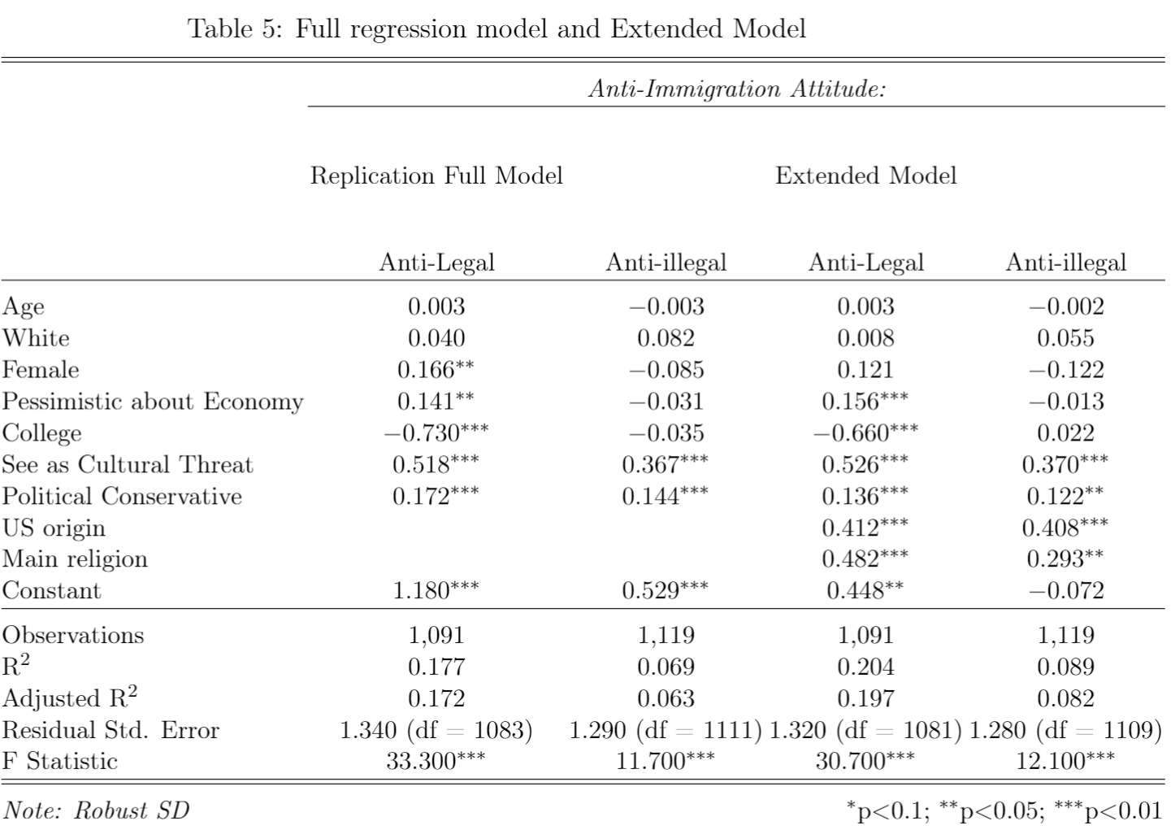

Slide 5
Data Exploration for Repeated study
Heat map for Data Exploration
Identify targeted year and available data.
Valid method for exploration in other topics and data set.

Slide 6
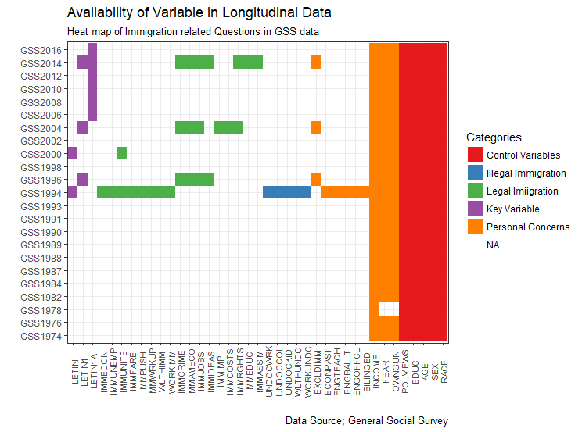

Slide 7
Model and method with penal data
Model Simplified model with available Variables
Dependent Variable: LETIN (Respondent wants More/Same level of/Less immigration)
Independent Variables:
Control variable: Personal Characteristic (gender, age, and ethnicity)
IV: Political View, Education level
Repeated For each survey

Slide 8
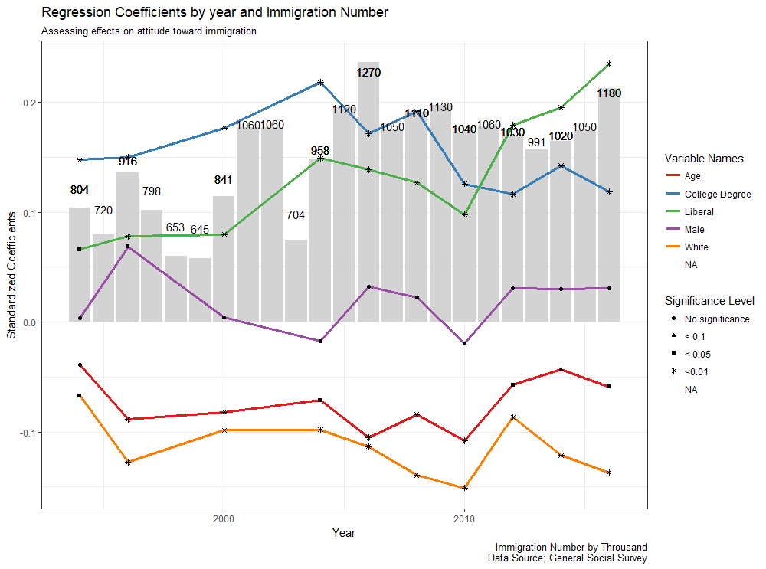

Slide 9
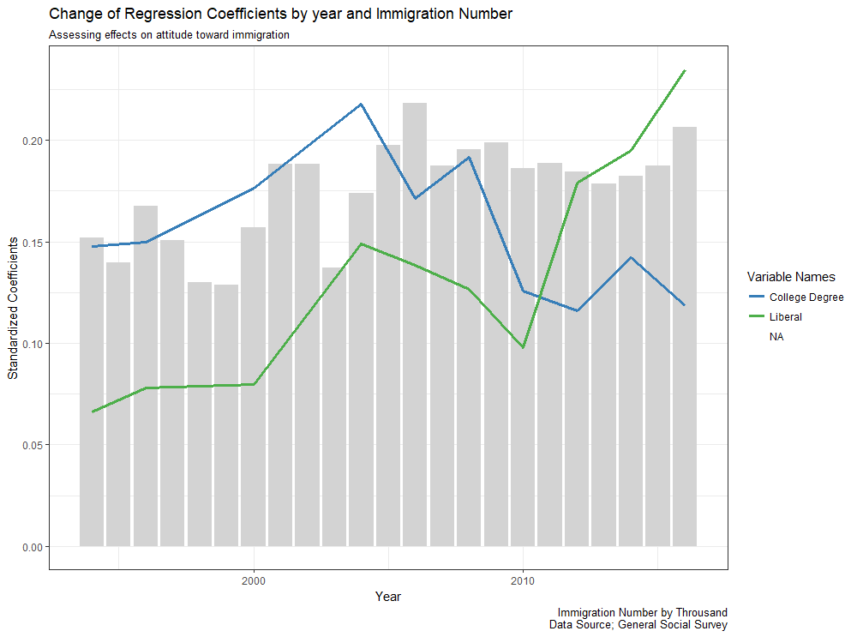

Slide 10
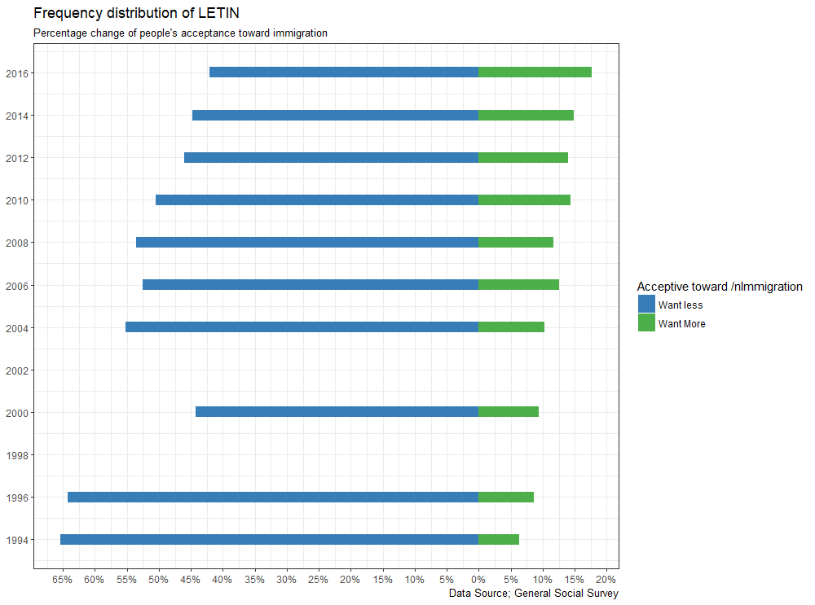

Slide 11
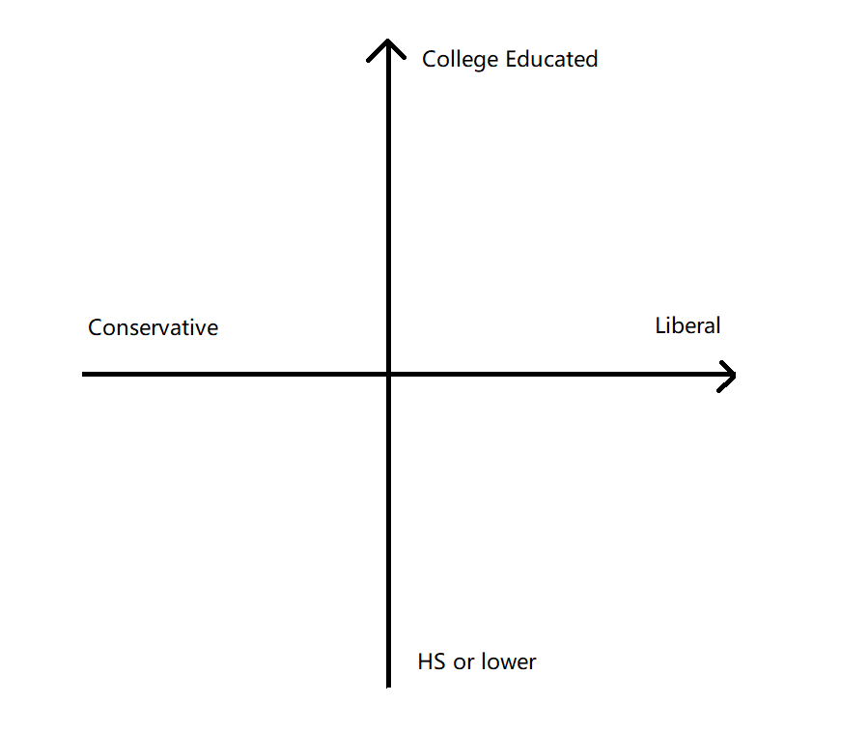
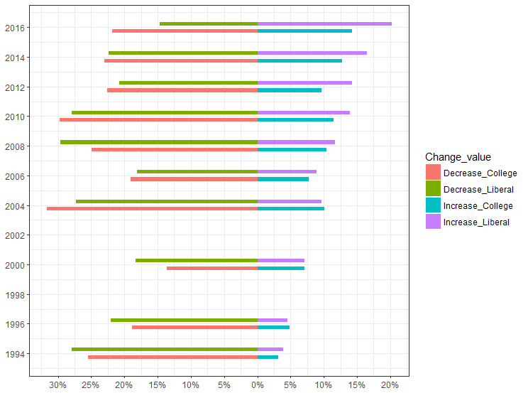
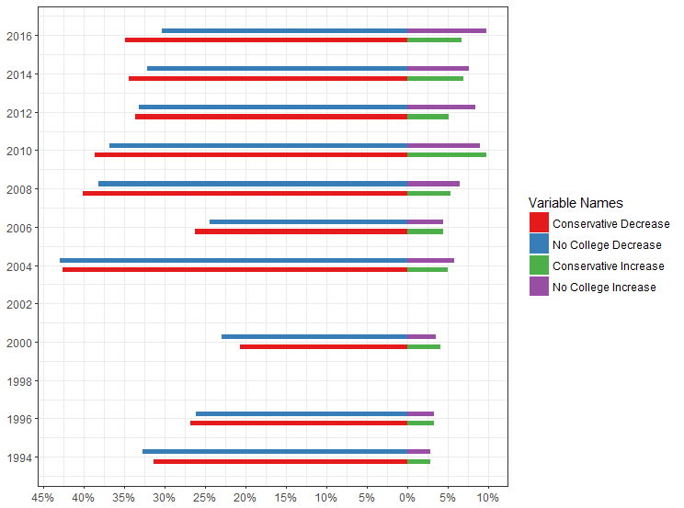

Slide 12
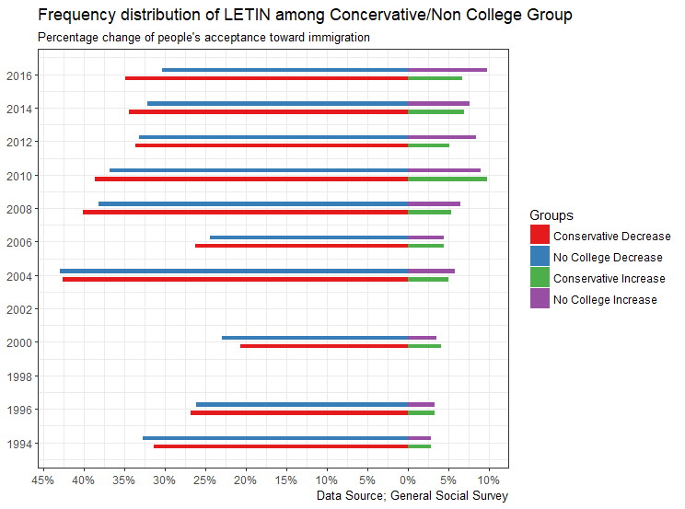

Slide 13
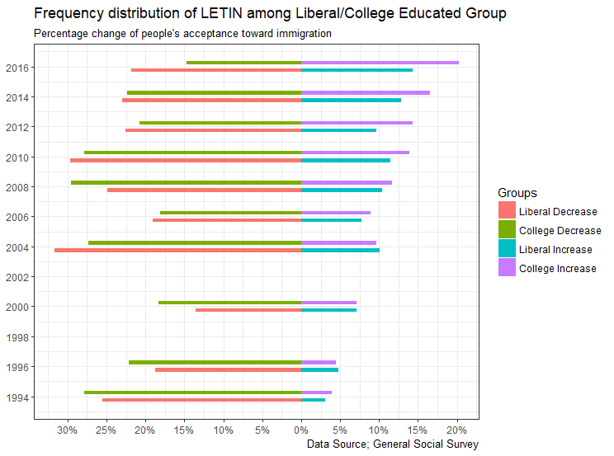

Slide 15
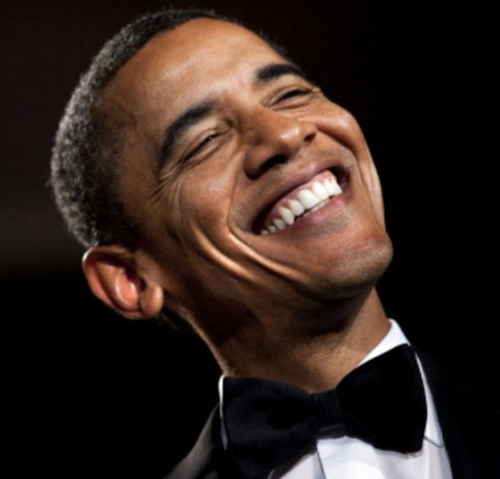
Conclusion
Aim: To explain the divergence of the effects of Political view and College education on public opinion toward immigration since 2010.
Tentative Explanation:
On their opinion toward immigration:
The liberal Americans has become…
- Maybe? People with higher education do not follow the exact same trend.
More “liberal” since 2010.

Slide 16


Slide 17
References
Butkus, M., Maciulyte-Sniukiene, A., Davidaviciene, V., & Matuzeviciute, K. (2016). Factors influencing society's attitudes towards internal and external EU immigrants. Filosifija sociologija., 27(4), 292.
Citrin, J., Reingold, B. & Green, D.P . (1990). American identity and the politics of ethnic change, Journal of Politics 52(4): 112
Chandler, R.,Charles & Tsai, Yung-mei (2001).Social factors influencing immigration attitudes: an analysis of data from the General Social Survey, The Social Science Journal 38(2001)
Espenshade, T. J. & Calhoun, C. A. (1993). An analysis of public opinion toward undocumented immigration. Population Research and Policy Review, 12, 189–224.

